Slide 1
INTRODUCTION
MY NAME IS MIRAL GOSWAMI.
I AM 19 YEARS OLD.
I PASSED OUT MY 12 FROM SHREE MACCHI MAHAJAN ENGLISH MEDIUM SCHOOL.
NOW I AM STUDYING IN GOVERNMENT COLLEGE , DAMAN.
MY HOBBY IS TRAVELLING AND READING.
I LIVE IN DAMAN, BUT I BELONG FROM GUJARAT.
MY VILLAGE NAME IS UNA , DISRICT: GIR SOMNATH.
MY FATHER NAME IS BATUKGIRI GOSWAMI.
MY MOTHER NAME IS REKHABEN GOSWAMI.
I HAVE 1 BROTHER AND 1 SISTER.
THERE ARE 5 MEMBERS IN OUR FAMILY.

Slide 2
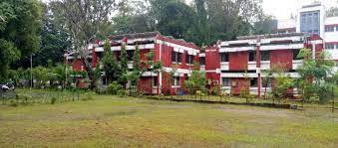
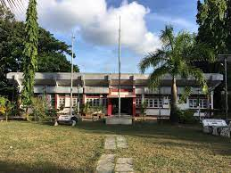
COLLEGE DETAILS
MY COLLEGE NAME IS GOVERNMENT ARTS, COMMERCE AND SCIENCE COLLEGE.
NOW I AM STUDYING IN B.COM THIRD YEAR.
I COMPLETE MY SECOND YEAR B.COM.
THIS IS MY COLLEGE PICTURE:

Slide 3
SELF PERFORMANCE
QUALIFICATION | MARKS | PASSING YEAR
SSC | 63.33% | 2019
HSC | 66.40% | 2021
BACHELOR OF COMMERCE | 70% | 2024

Slide 4
FUTURE ACTIVITY
IN FUTURE, AFTER B.COM I START MY PREPARATION OF GPSC.
MY AIM IS BECOME TO IPS OFFICER.
I CHOOSE IPS OFFICER BECAUSE OF SERVE THE COUNTRY.
I WOULD TO MAKE THE COUNTRY CRIME FREE.
NOW MY SSC EXAM PREPARATION IS GOING ON.
WITH GPSC EXAM I ALSO PREPARED FOR SSC EXAM.

Slide 5
AREA OF INTEREST
MY AREA OF INTEREST IS TRAVELLING, PLAYING GUITAR AND READING.
I LIKE TO TRAVEL AT DIFFERENT PLACE.
I WOULD LIKE JOURNEY ALL OVER THE WORLD.
MY DREAM IS TO GO TO KEDARNATH.
I WANT TO LEARN PLAYING A GUITAR.
ALSO I LIKE TO READING DIFFERENT BOOKS BECAUSE OF GENERAL KNOWLEDGE.
MY INTEREST TO READ AND KNOW ABOUT THE WORLD.

